Slide 1
Pose2Seg

Slide 2
Human detection Problem
Human pose estimation and segmentation are important information to have better understanding about human activity. There are lots of research focused on this topic. One of the most popular deep learning methods is Mask R-CNN which is a simple and general framework for object instance segmentation.

Slide 3
Problem with Mask R-CNN
These methods perform the object detection first, then remove the redundant regions using Non-maximum Suppression (NMS) and segment the object from the detection bounding-box. When two objects of the same category have a large overlap, NSM will treat one of them as a redundant proposal region and eliminates it.
“Human” is a special category and can be defined based on the pose skeleton. The current methods like Mask-RCNN don’t take advantage of the pose information for segmentation.

Slide 4
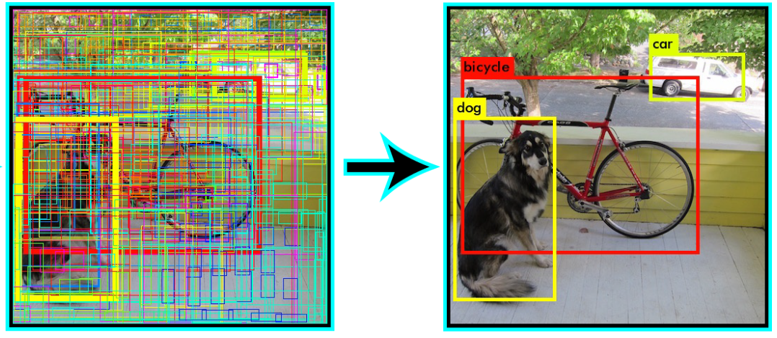

Slide 5
Idea
Use bottom-up approaches which is based on the pose information rather than the bounding box detection.
Designed to solve the occlusion problem where each human instance is heavily occluded by one or several others.
The main idea of the bottom-up methods is to first detect keypoints for each body part for all the people, and then group or connect those parts to form several instances of human pose, which makes it possible to separate two intertwined human instances with a large overlap

Slide 6
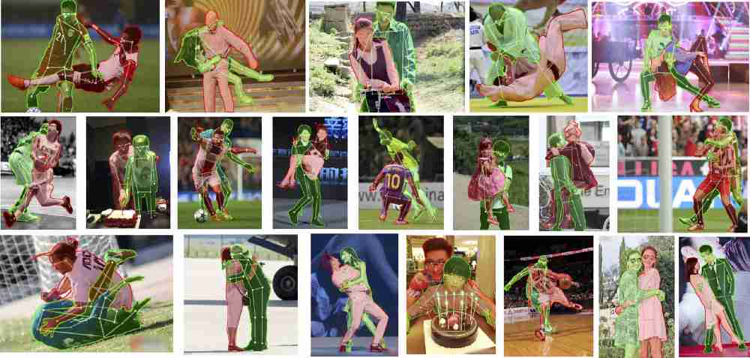
Occluded Human Benchmark (OCHuman)

Slide 7
OCHuman is designed for all three most important tasks related to humans
Detection
Pose estimation
Instance segmentation.
The most important aspect of OCHuman is the average MaxIoU which is 0.67. That means over 67% of the bounding-box area of a human is occluded by one or several other persons. This is a very common problem in real life applications such as video surveillance or in-store human behaviour analysis.

Slide 8
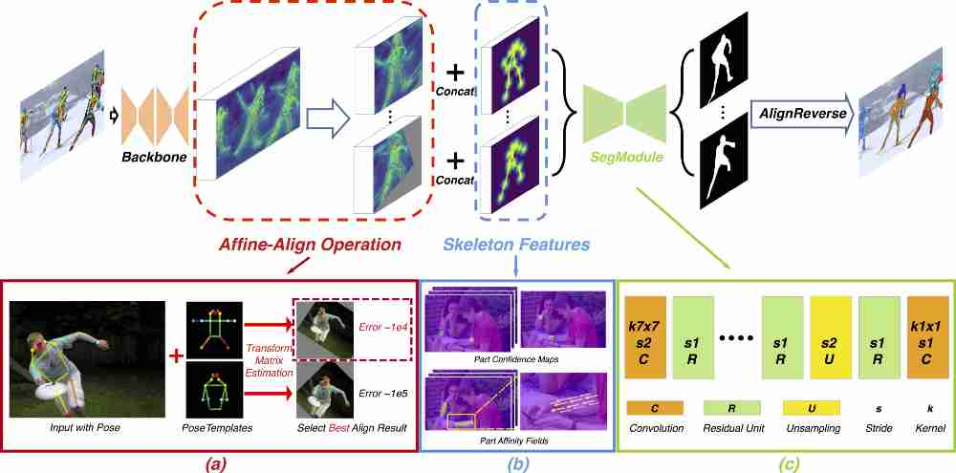

Slide 9
Algorithm
First, the model takes both the image and human pose as input. The human pose can be the output of other methods such as OpenPose or the ground truth of the dataset.
The entire image is passed through a base network to extract features of the image.
An align module, Affine-Align, is used to align Regions of Interest to a uniform size. You can imagine that this module will extract multiple fixed-size regions from the large image. Each fixed-size region is correspond for each human in the image.

Slide 10
Then, the Affine-Align region will perform affine transformations to align each pose to one of the pose templates.
The aligned output of the Affine-Align will be concatinated with Skeleton Features and feed toward a SegModule to generate the segmentation mask.
Skeleton features: are simply the part affinity fields (PAFs) which is a 2-channel vector field map for each skeleton. This is the output of the OpenPose.
SegModule: is a CNN network which starts with 7 x 7 stride-2 conv layer and is followed by several standard residual units. Then, a bilinear upsampling layer is used to recover the resolution and 1 x 1 conv layer are used to predict the mask result.
Finally, the segmentation masks for each person is combined into one final segmentation mask using the reverse of the affine transformation from Affine-Align.

Slide 11
Affine Align
The Affine-Align operation is mainly inspired by the RoI-Pooling presented in Faster R-CNN and RoI-Align in Mask R-CNN. But, while those align human according to their bounding-boxes, Affine-Align is used to align based on human pose.
To do that, the most frequent human poses are stored offline, later to be compared with every input pose at training/inference (see Figure 5 below). The idea is to choose the best template for each estimated pose. This is accomplished by estimating an affine transformation matrix H between input pose and the templates and choosing the one yielding the best score.

Slide 12
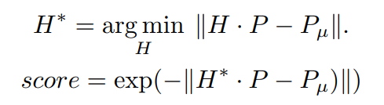
Here P_u represent a pose template and P represent a single person pose estimation. The matrix H* is the affine transform chosen for the best suited per pose template. Finally, The transformation H* that results with the best score is applied on the image or features and transform it to the desired resolution.

Slide 13
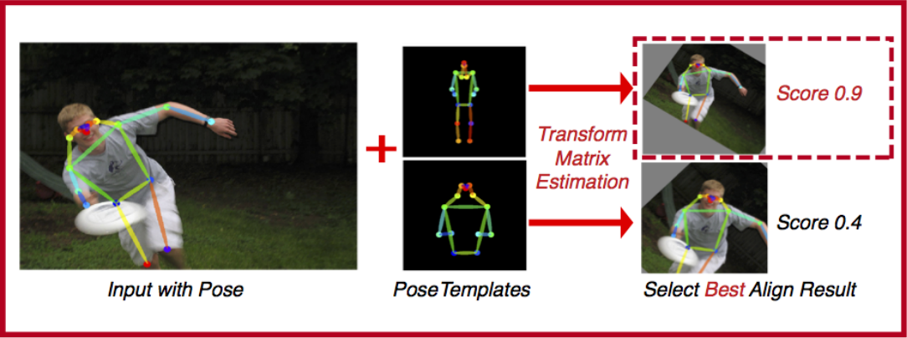

Slide 14
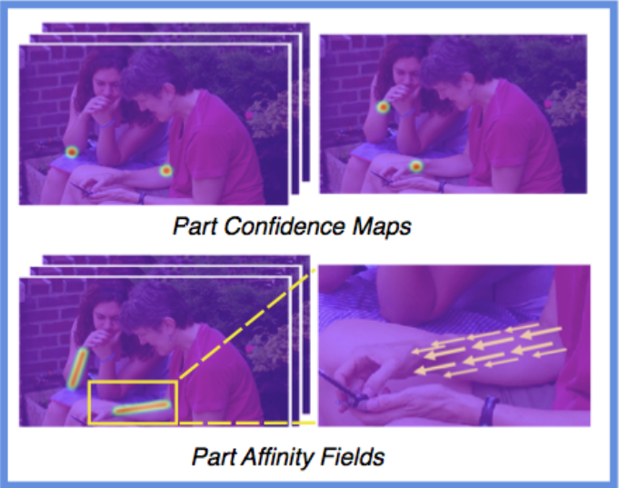
Skeleton Features
Figure shows the skeleton features. For this task part affinity fields (PAFs) is adopted. The output from PAF is a 2-channel vector field map for each skeleton. PAF is used to represent the skeleton structure of a human pose along with a part confidence maps for body parts to emphasize the importance of those regions around the body part keypoints.

Slide 15
SegModule
The networks starts with a 7 × 7, stride-2 convolution layer, and is followed by several standard residual units to achieve a large enough receptive field for the RoIs. After that, a bilinear up-sampling layer is used to restore the resolution, and another residual unit, along with a 1 × 1 convolution layer are used to predict the final result. Such a structure with 10 residual units can achieve about 50 pixels of receptive field, corresponding to the alignment size of 64 × 64. Fewer units will make the network less capable of learning, and more units enable little improvement on the learning ability.

Slide 16
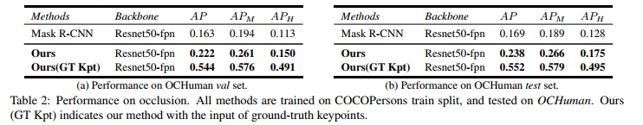
Pose2Seg can achieve nearly 50% higher than the Mask R-CNN on OCHuman dataset. The author also tests using the ground-truth keypoints as input and more than double the accuracy (GT Kpt).

Slide 17
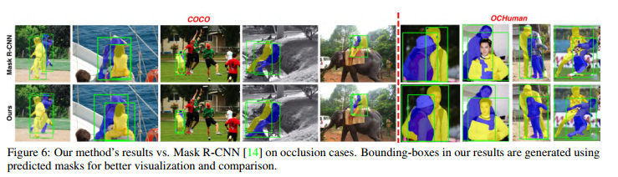

Slide 18
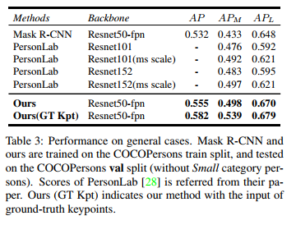
Performance on COCO dataset

